Slide 1
Module 4: External Links and Embedded Pages
SER 423

Slide 2
Overview
In apps, we often want to display external content
This can be either displaying content from a webpage or actually linking the User directly to one
Common use examples would be: account creation, terms and conditions, help and support, extra documentation, etc.
We have ways to do either of these in our apps
This topic is a precursor to what we will talk about in the next Module, which is getting data remotely
We’ll start with the simpler task of getting directly to webpages

Slide 3
Embedding Sites

Slide 4
Using WebView
There is a type of View called WebView which we can give a URL to display
It has a source property which we set as the URL
We can then treat it like any other View
For now, we can assume the URLs will be static
You may eventually want to fetch dynamic URLs while the app is running but again the next module will give you ways to do that
Since we’re using static URLs, we can just create an array of them and store it in state
  Of course, if you only have one URL then no array is needed
The example from the book uses StackNavigator to switch between a View with a list of buttons and a single WebView displaying the chosen URL
  We won’t dive into that part of the example in this, but I encourage you to on your own if you’re curious about StackNavigator as it is a nice way of moving between Views

Slide 5
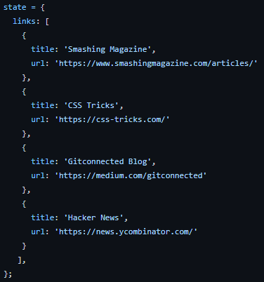
Declaring the Links

Slide 6
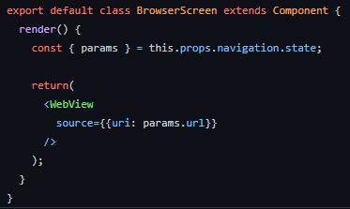
The WebView Itself

Slide 7
Linking to External Sites

Slide 8
Using the External Links
Sometimes a WebView may not be enough
In particular, if the User will need to navigate around multiple pages on the site it can become difficult to use WebView for this
It may be better to instead link the User to the website directly
Rather than loading it up within your app, have the device browser open it up for you
This then gives the User the typical browsing experience
The User will then return to the app on their own
Also, we can use the same technique to not only open web pages, but also other apps on the device
For example, you could have a button that says “Contact Us” that opens the email app on the device

Slide 9
Using the Linking Library
React native provides us with a library called Linking which we can use for this
As before, we can create an array of links
The difference this time is that the URL field will have a protocol in front of it if it is not a regular web page link
  ie. “mailto:support@gmail.com”
Expo has a library called WebBrowser for opening a page within the app
However, the general use case would be to stick with the Linking library
We can just call Linking.openURL and pass in the URL
  This works even on those URLs that are not a webpage

Slide 10
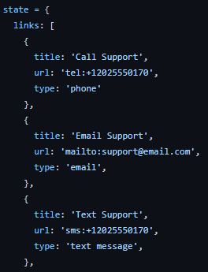
Link Creation

Slide 11
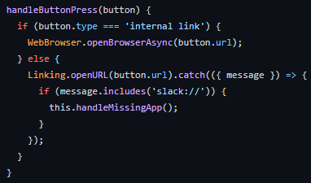
Opening the Links

Slide 12
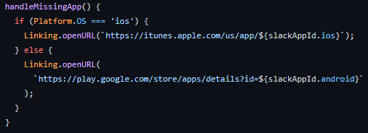
More Link Opening

Slide 13
End of External Links
That’s all for Module 4

